Slide 1
Project 2
By Alex Lu
April 2019

Slide 2
Problem
Question 1: Do discounts have a statistically significant effect on the number of products customers order? If so, at what level(s) of discount?
Question 2: Is there a significant different in the basket value (ie total sales revenue per order) when there is a discount?
Question3: Is the average sales value per transaction higher in UK than the rest of the world?
Question 4: Is there a difference in sales value per order when it is executed by a younger employee vs an older employee?

Slide 3
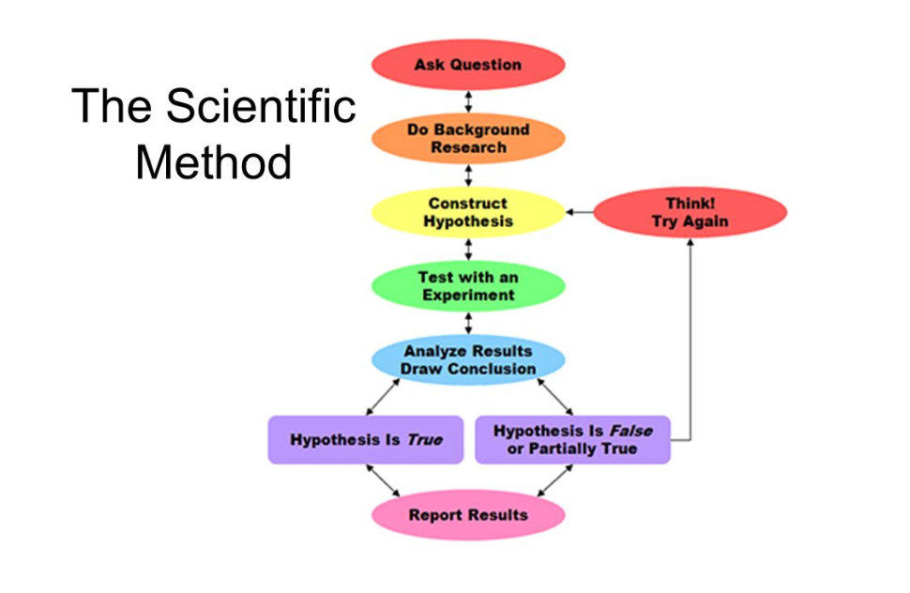
Methodology

Slide 4
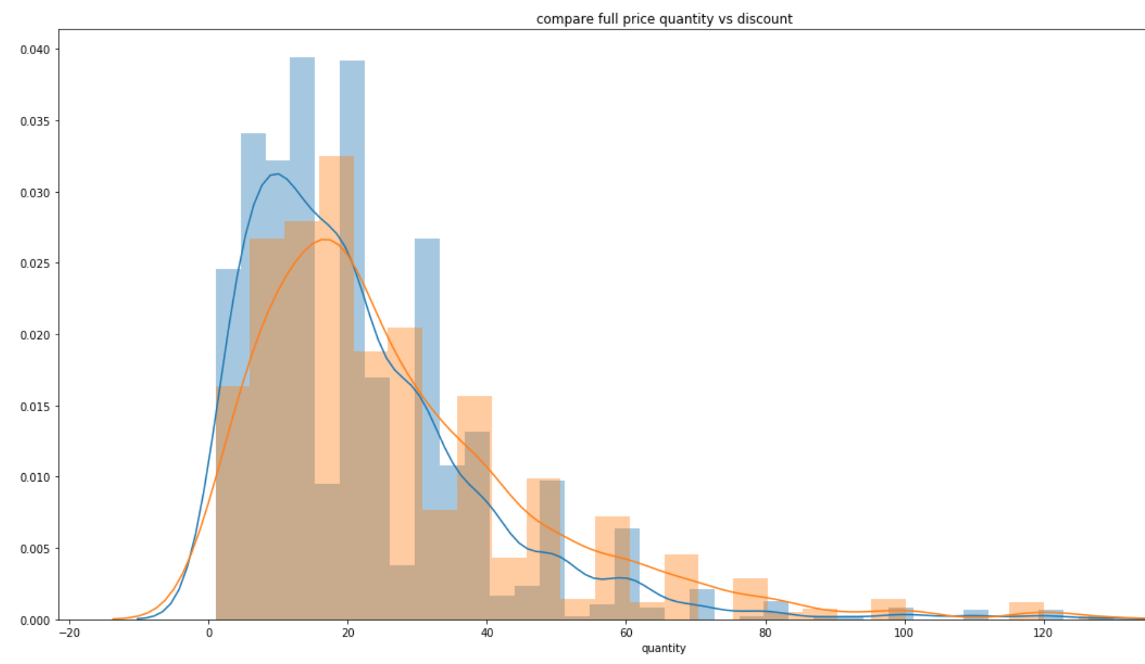
Question1
Do discounts have a statistically significant effect on the number of products customers order? If so, at what level(s) of discount?
Null Hypothesis (H0): Discount has no statistical significant relationship to number of products customer orders. mu_fp=mu_disc (mu_fp is the mean of full price quantity. mu_disc is the mean of discount quantity.)
Alternative(H-alpha): Discount has a statistically significant impact to the number of products customer orders. Alpha is set to 0.05. mu_fp!=mu_disc

Slide 5
Question1: Results
1) p-value=1.1e-10
p< alpha: reject null hypothesis. there is a statistical significance between discount and quantity purchase
2) Cohen D test =0.286
Cohen d value seems to suggest that there is a small to medium effect difference.
3) Tukey Test
From the Tukey test, only 5%, 15%, 20% and 25% are significant. among those, the mean difference in 15% is the greatest, so it is saying that 15% makes the biggest difference, however it is marginal.
4) Business implication
If the company's KPI is to sell as much quantity as possible, then they should certainly apply discount promotion, and 15% seems to be the most effective. However without knowing the net profit margin after discount (or amount of mark up before discount), it is difficult to make a recommendation to what discount should be applied. The company should further investigate what % discount would have the greatest effect and yet bring in the highest net profit.

Slide 6
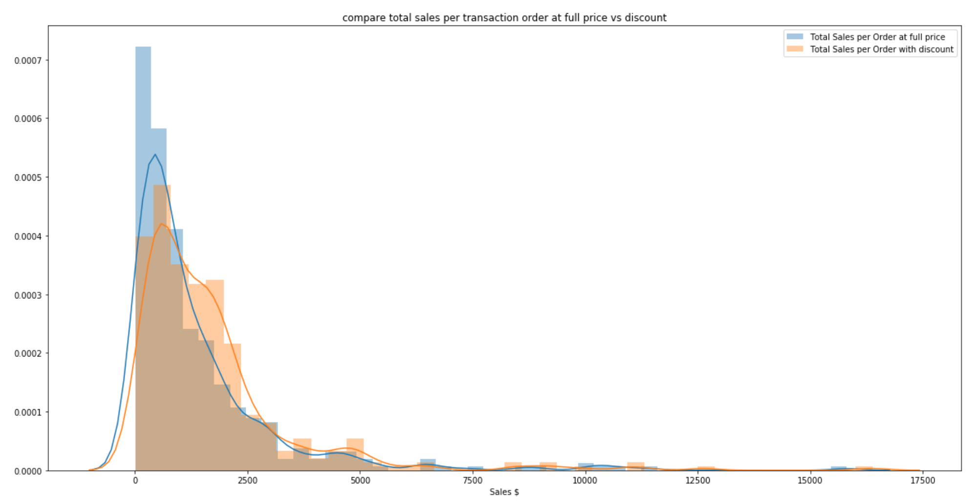
Question2
Is there a significant different in the basket value (ie total sales revenue per order) when there is a discount?
H0: total sales per order is not influenced by any discount. ie. mu (total sales per order in the absence of any discount) = mu(total sales per order with presence of any discount)
H1: total sales per order is influenced by presence of any discount. ie. mu (total sales per order in the absence of any discount) != mu(total sales per order with presence of any discount)

Slide 7
Question2: Results
1) P-value=0.01
pvalue suggests that there is a statistical significance in the total purchase value when there is a presence of discount. (ie people are buying more per transaction.)
2) Cohen D=0.18
Cohen D test number suggests that the difference in the total transaction value is small, despite that there is a statistic significance when there is a presence of discount.
3) Business Implication
The total sales revenue per order does seem to increase when there is presence of discount, but not significant. This suggests that if the company’s KPI is to increase top line revenue, then they should always be running some sort of discount. However, if the KPI is to increase net profitability, further investigation is needed.

Slide 8
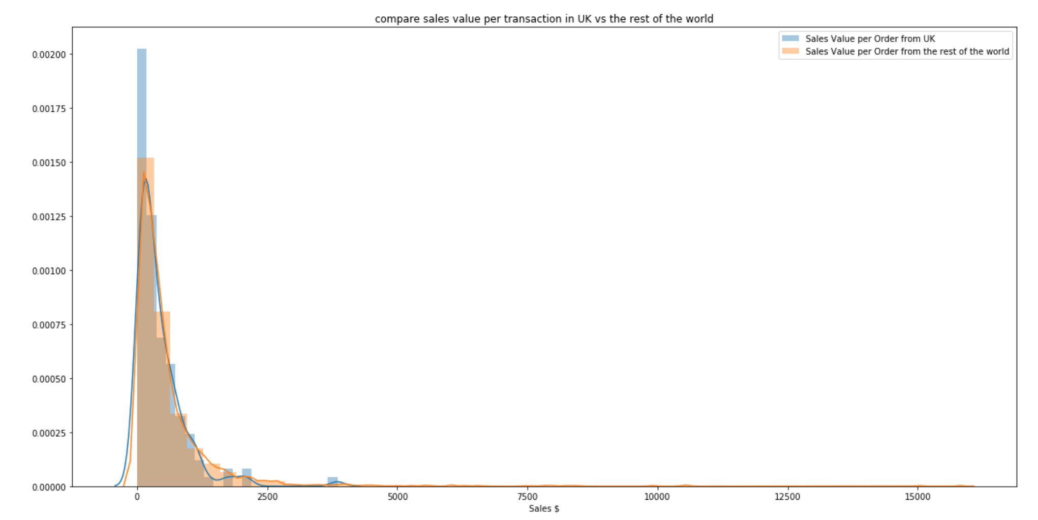
Question3
Is the average sales value per transaction higher in UK than the rest of the world?
H0: mu of UK sales value per transaction = mu of sales value per transaction other countries
H1: mu of UK sales value per transaction != mu of sales value per transaction of other countries

Slide 9
Question3: Results
1) p-value = 0.0576
Pvalue is greater than alpha 0.05. Hence we accept the null hypothesis that there is no statistical significant evidence that UK average sales value per order is different from the rest of the world.
2) Business Implication
From a business prospective, the company probably shouldn't spend above normal budget in UK marketing, as the purchasing power from UK seems to be average or inline with the rest of the world.

Slide 10
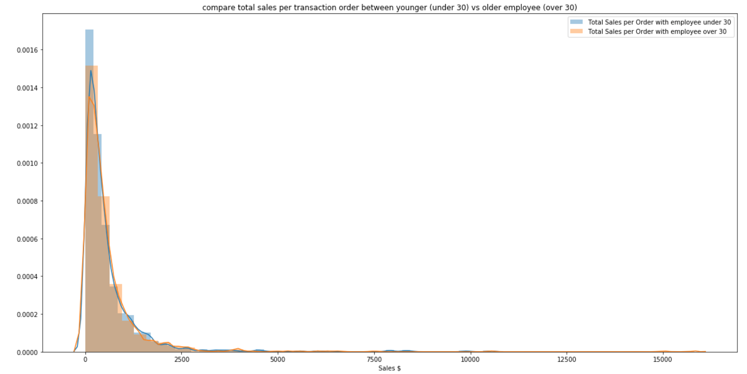
Question4
Is there a difference in sales value per order when it is executed by a younger employee vs an older employee?
H0: mu of sales value per order executed by a younger employee (under 30) = mu of sales value per order executed by an older employee (above 30)
H1: mu of sales value per order executed by a younger employee != mu of sales value per order executed by an older employee

Slide 11
Question4: Results
1) p-value = 0.97
Pvalue is greater than alpha 0.05, hence we accept our null hypothesis there is no difference in sales value per order when it is executed by a younger employee vs an older employee..
2) Business Implication
From business' prospective, if it is cheaper to hire younger employee, then they should do so.

